Slide 1
E-Commerce Churn Analysis
Muhammad Mahesa
Muhammad Yogi Ilham

Slide 2
Table of contents
Business Problem
Exploratory Data Analysis
01
02
Machine Learning
Conclusion and Recommendation
03
04

Slide 3
01
Business Problem

Slide 4
Business Background
Our Team
Stakeholders
Data
Cost
Data science / analyst team
Tasked to reduce churn rate of an e-commerce company
Business Development Team
Growth Team
5630 Rows & 18 features
2021 data
Imbalance dataset (16.8% churn customers)
New customer acquisition cost = $40
Customer retention cost = $10

Slide 5
Understanding Problem
Situation
Complication
Key Questions
Some E-commerce company customers stopped buying at certain point. Customers also has low switching cost to other competitors
Losing customers is bad for business because customer acquisition cost is more expensive than customer retention
How to identify churning customers so we can prevent it from happening?
Notes:
State stakeholder, data tahun berapa, role kita apa

Slide 6
Data Understanding
Variable | Description | Unit | Values
CustomerID | Unique customer ID | ID | 5001-55630
Churn | Churn Flag | Label | 0 & 1
Tenure | Tenure of customer in organization | Month | 0-60
PreferredLoginDevice | Preferred login device of customer | Device | Computer, Mobile Phone, Phone
CityTier | City tier | Tier | 1,2,3
WarehouseToHome | Distance in between warehouse to home of customer | Mile | 5-127
PreferredPaymentMode | Preferred payment method of customer | Method | Credit Card, Debit Card, Cash on Delivery, CC, UPI, COD, E Wallet
Gender | Gender of customer | Gender | Male, Female
HourSpendOnApp | Number of hours spend on mobile application or website | Hours | 0-5

Slide 7
Data Understanding
Variable | Description | Unit | Values
NumberOfDeviceRegistered | Total number of deceives is registered on particular customer | Number of Device | 1-6
PreferedOrderCat | Preferred order category of customer in last month | Category | Fashion, Grocery, Laptop & Accessory, Mobile, Mobile Phone, Others
SatisfactionScore | Satisfactory score of customer on service | Rating | 1-5
MaritalStatus | Marital status of customer | Status | Divorced, Married, Single
NumberOfAddress | Total number of added added on particular customer | Count of Address | 1-22
Complain | Any complaint has been raised in last month | Label | 1-0
OrderAmountHikeFromlastYear | Percentage increases in order from last year | % | 11-26
CouponUsed | Total number of coupon has been used in last month | Coupon | 0-16
OrderCount | Total number of orders has been places in last month | Count | 1-16

Slide 8
Metrics
 | Not Churn Predict (0) | Churn Predict (1)
Not Churn Actual (0) | Model correctly predicts customers will not churn while in actual will not churn | Model predicts customers will churn while in actual customer will not churn
Churn Actual (1) | Model predicts customers will not churn while in actual customer will churn | Model correctly predicts customers will churn while in actual will churn
False negative is more costly, hence recall is the appropriate metrics

Slide 9
02
Exploratory Data Analysis

Slide 10
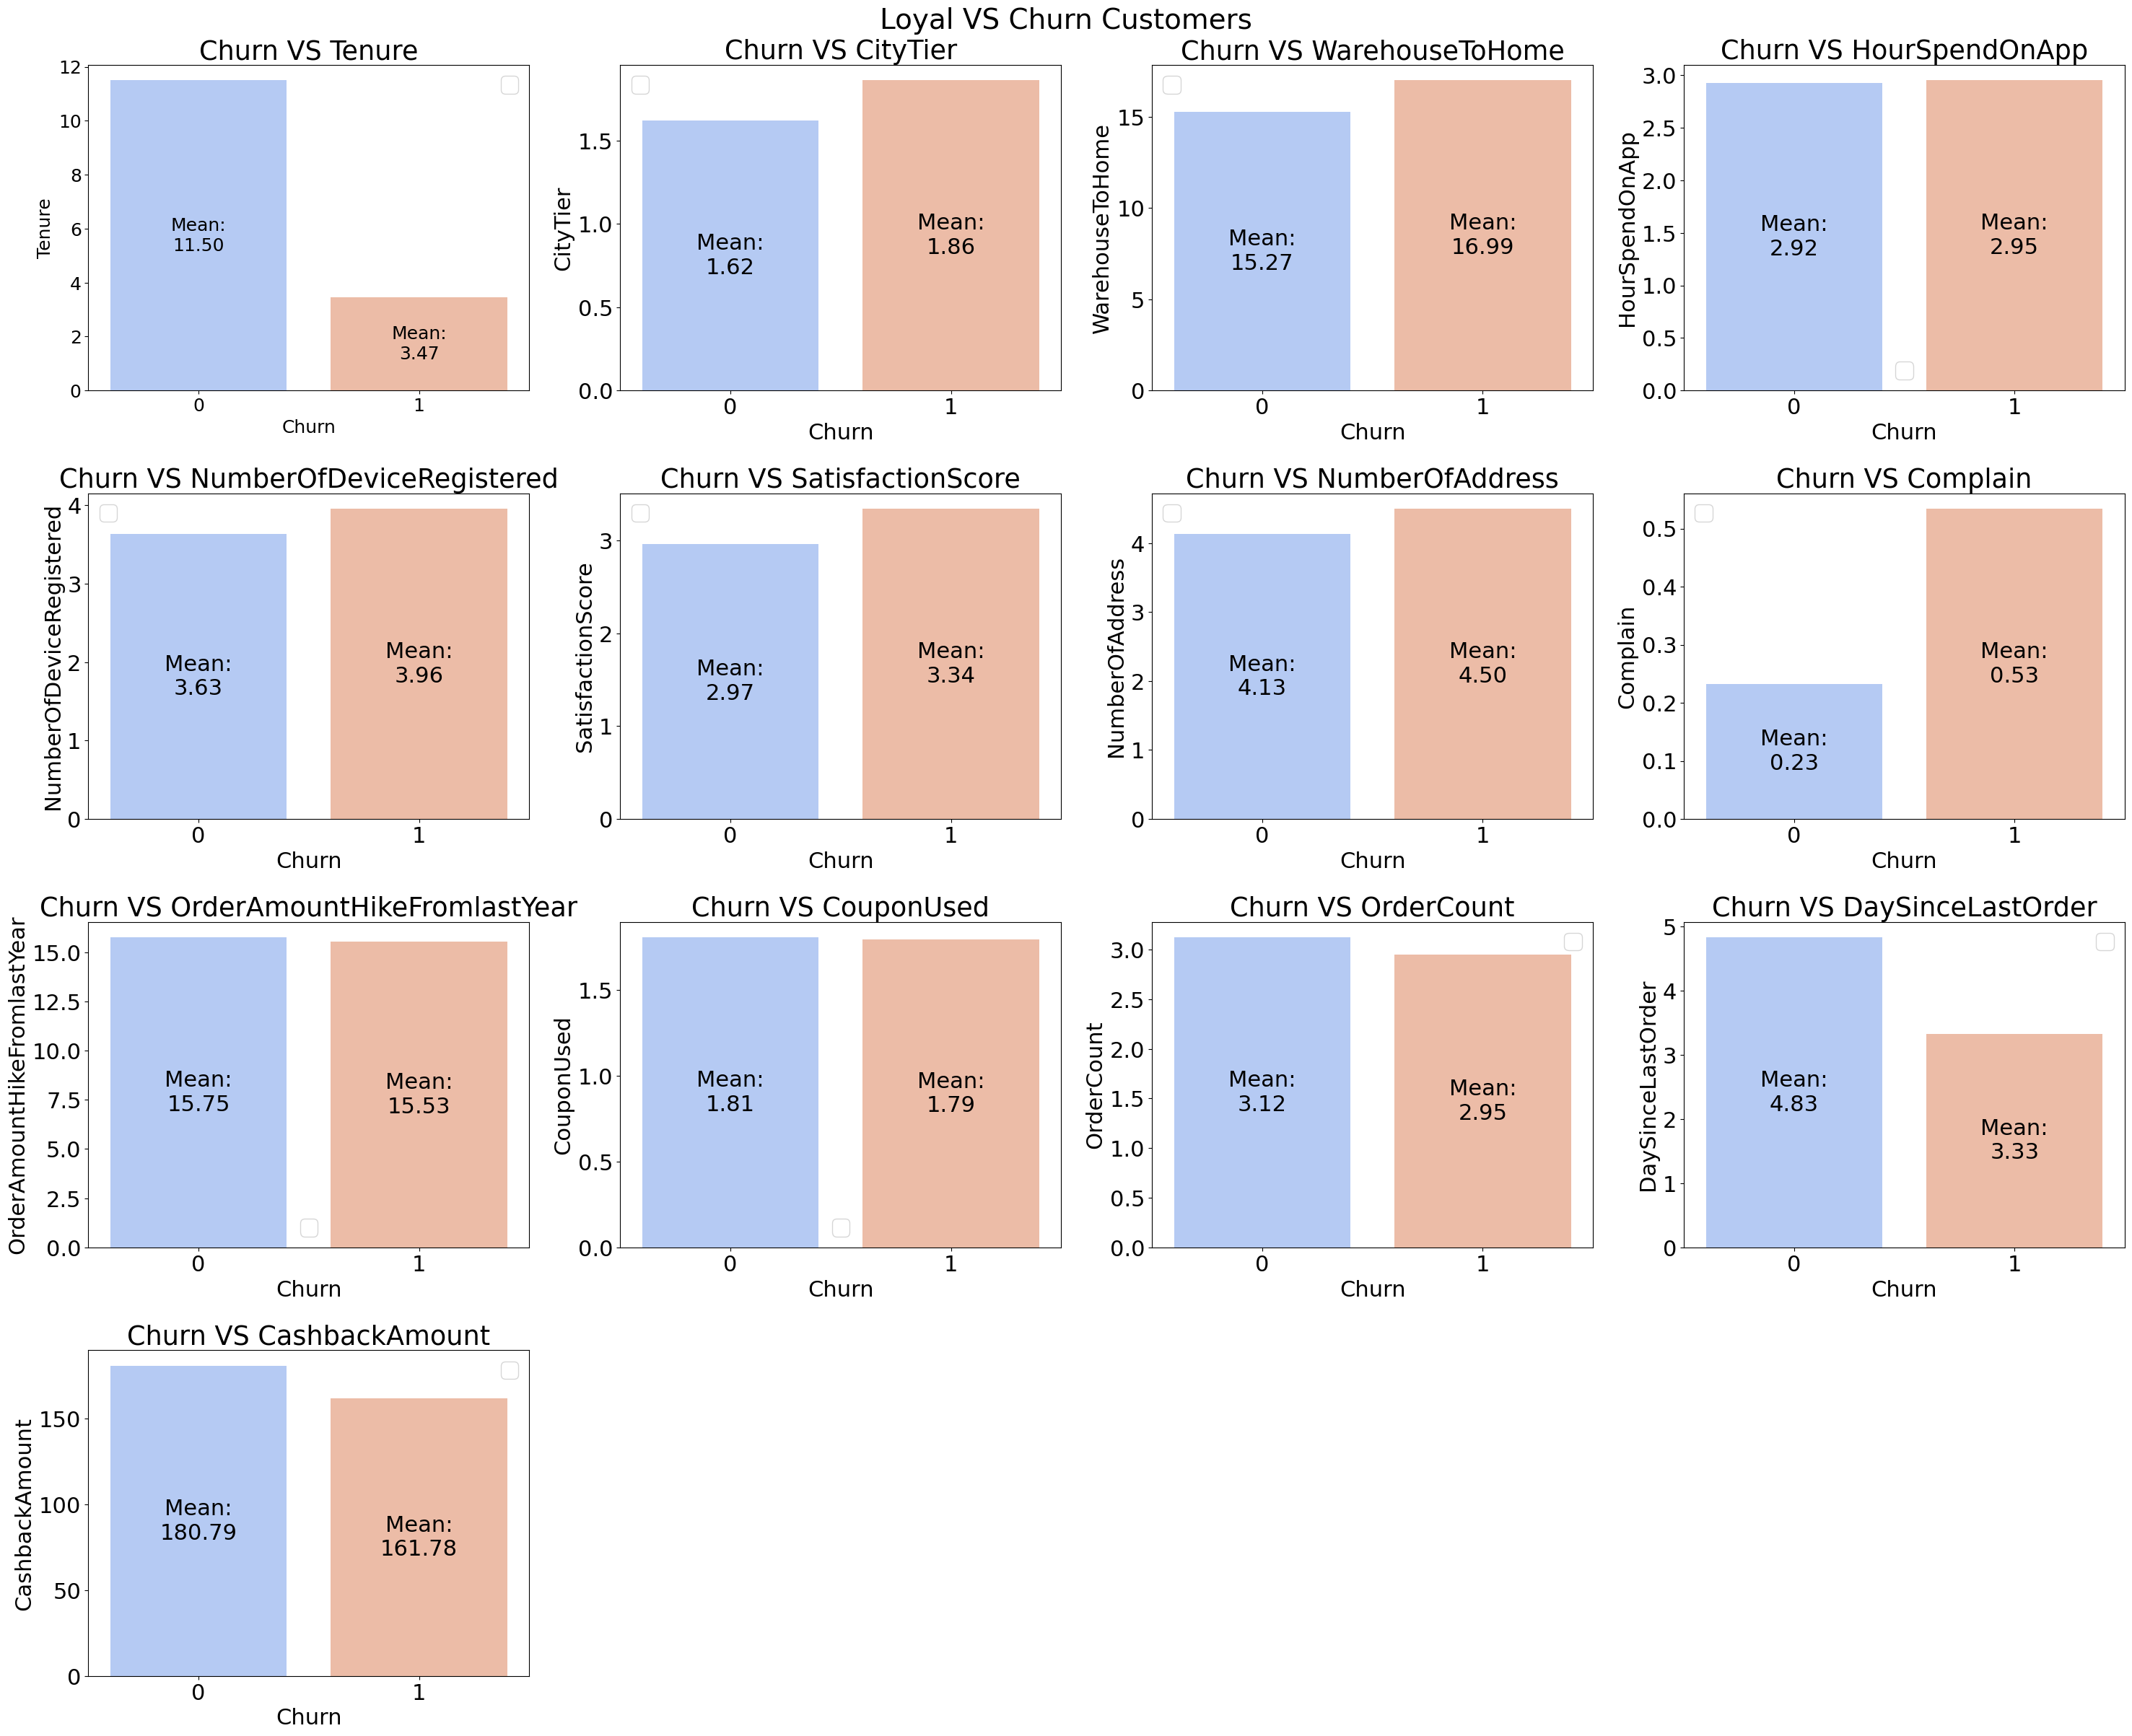
Churn VS Loyal Customers
Method | Process | Interpretation
Mann-Whitney | Comparing means of churn and loyal group | If significant difference exist, we can conclude different treatment exist
Notes:
Yang diutamakan adalah grafiknya, pecah jadi grup ada signifikan dan tidak signifikan, yang berbeda signifikan dijelaskan detail per slide

Slide 11
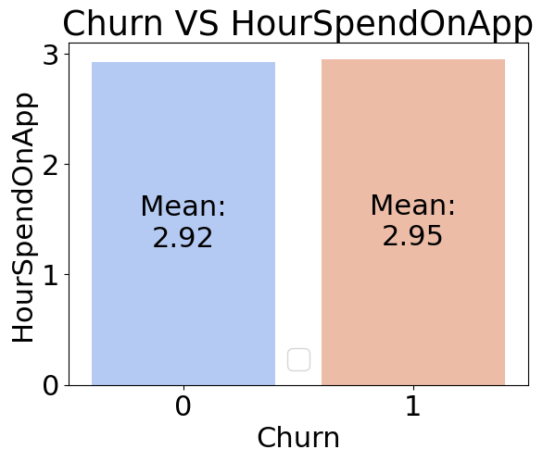
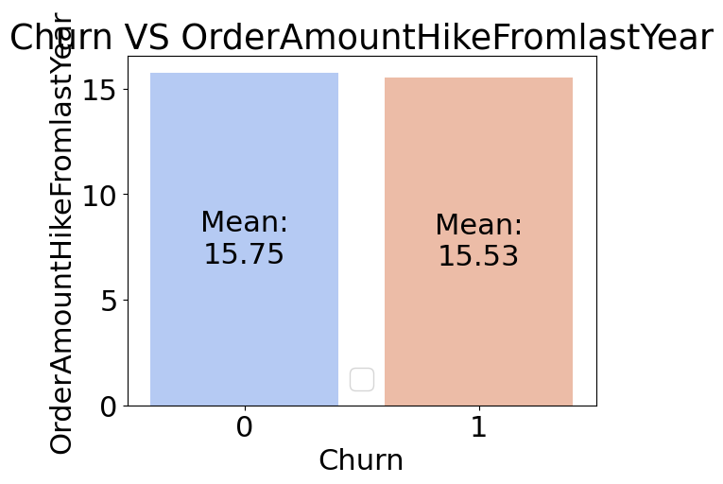
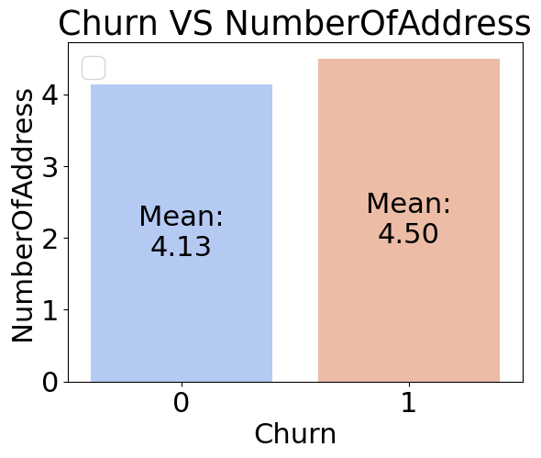
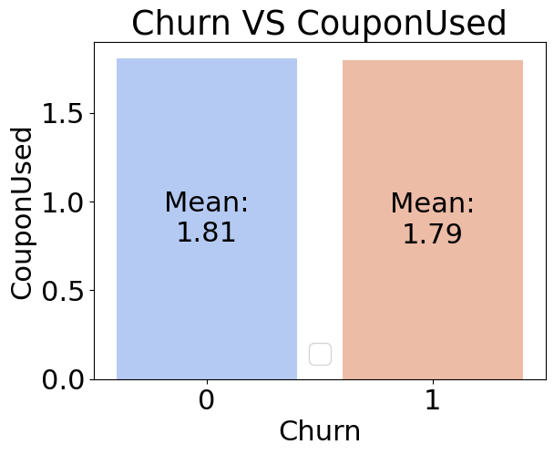
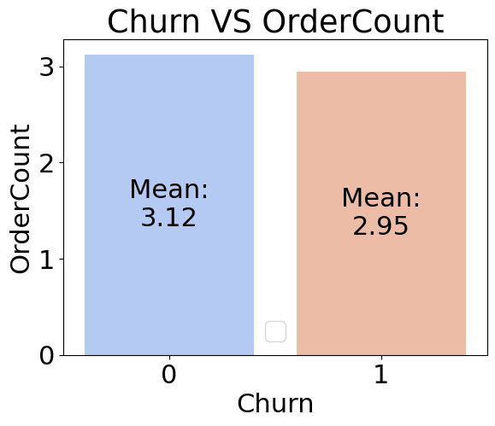
Churn and loyal group has same exp
 | Factor | Significant Diff | Interpretation
1 | Hour spend on app |  | Both group received same treatment
2 | Number of address
3 | Order hike
4 | Coupon used
5 | Order count
Notes:
Tunjukkan barplot

Slide 12
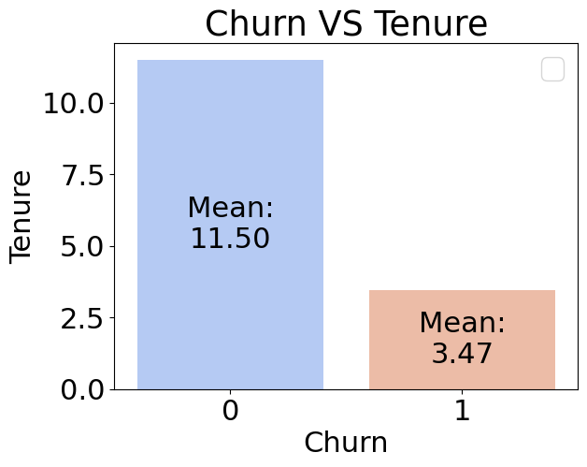
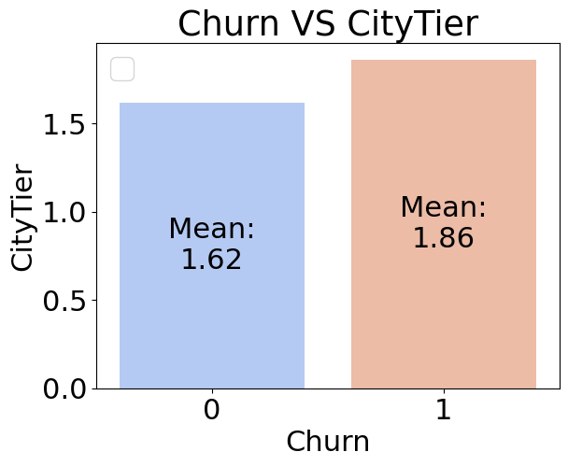
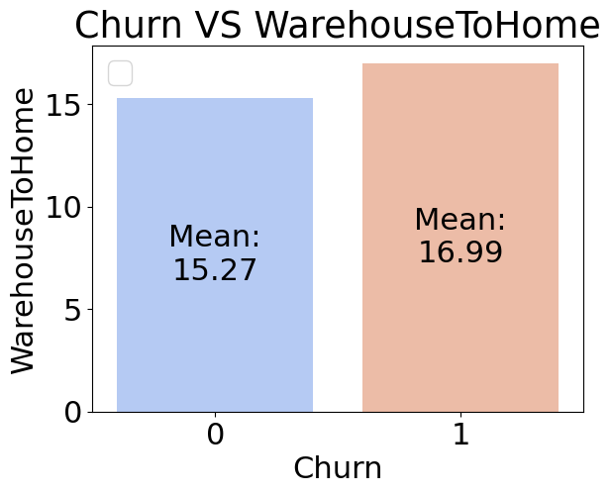
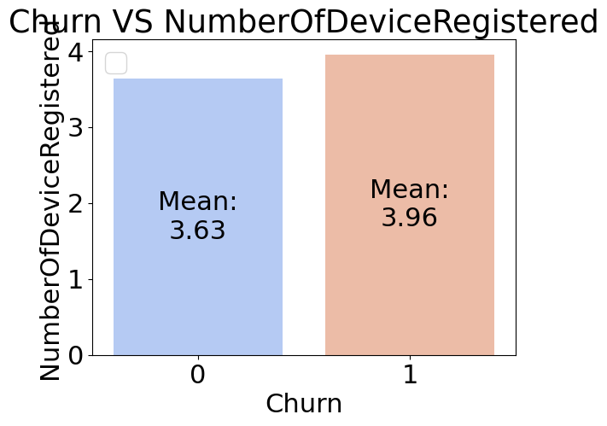

Exist different experience
 | Factor | Significant Diff | Interpretation
1 | Tenure |  | Older customers tend to be more loyal.
2 | City Tier |  | Customers from city tier 2 and 3 tend to churn more.
3 | Warehouse to home |  | Customers who live further from the warehouse tend to churn more, possibly due to longer delivery times
4 | Number of device registered |  | Churning customers have a higher number of devices registered.

Slide 13
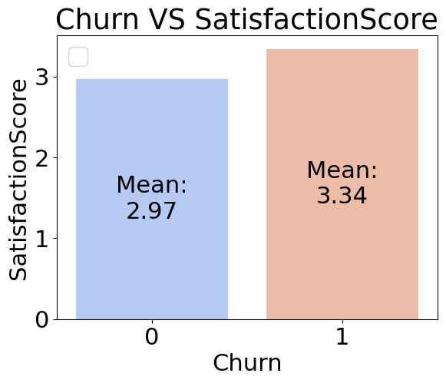
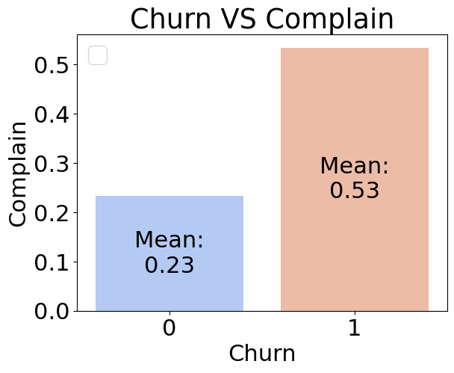
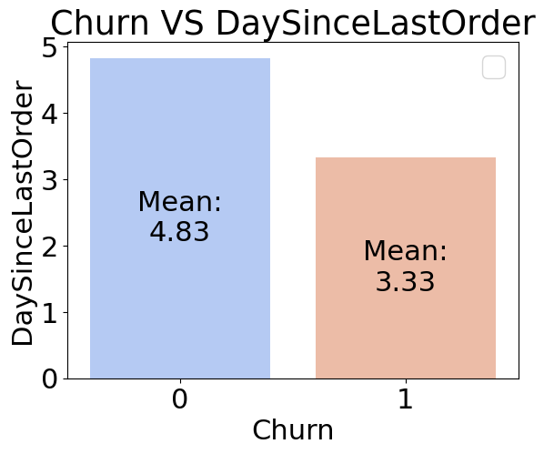
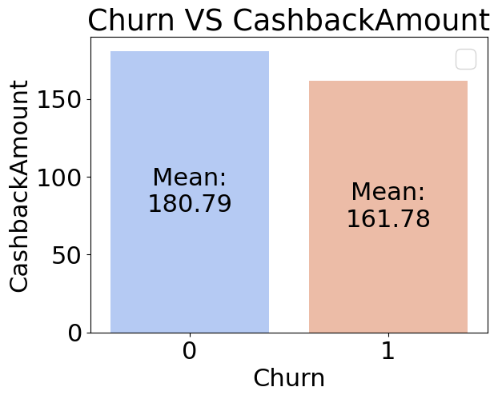
Exist different experience
 | Factor | Significant Diff | Interpretation
5 | Satisfaction score |  | Interestingly, customers who rate high satisfaction tend to churn more
6 | Complain |  | Customers who complain are more likely to churn.
7 | Day since last order |  | Customers who bought things recently are more likely to churn.
8 | Cashback amount |  | Customers who has less cashback amount are more likely to churn

Slide 14
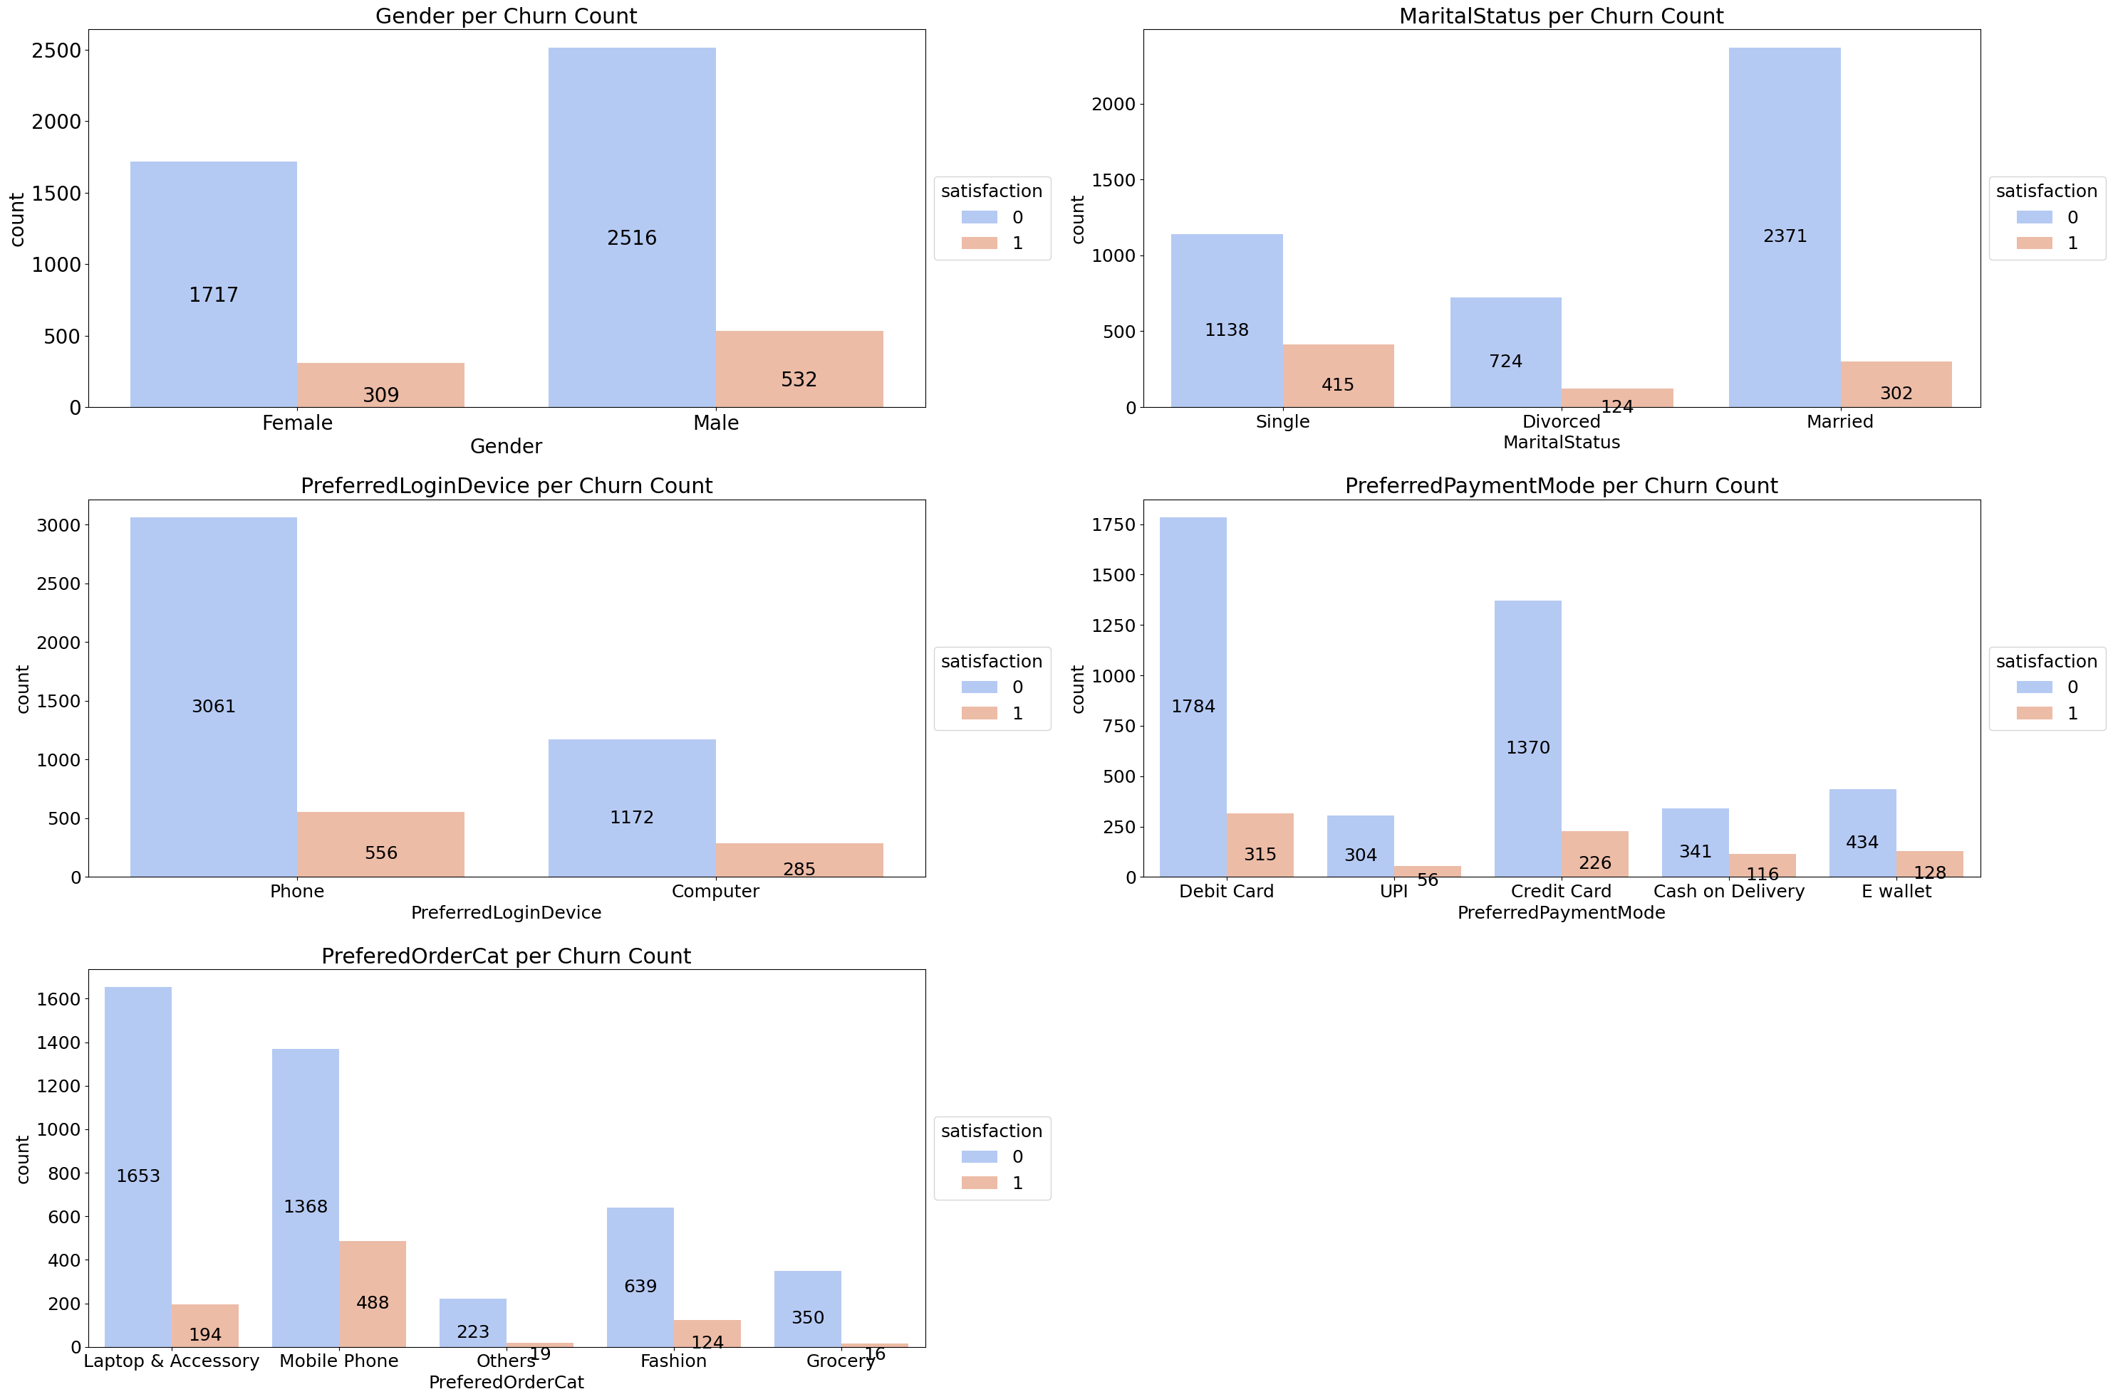
Chi-Square Test
Method | Process | Interpretation
Chi-Square | Comparing frequencies of churn and loyal group | If significant difference exist, we can conclude relationship exist

Slide 15
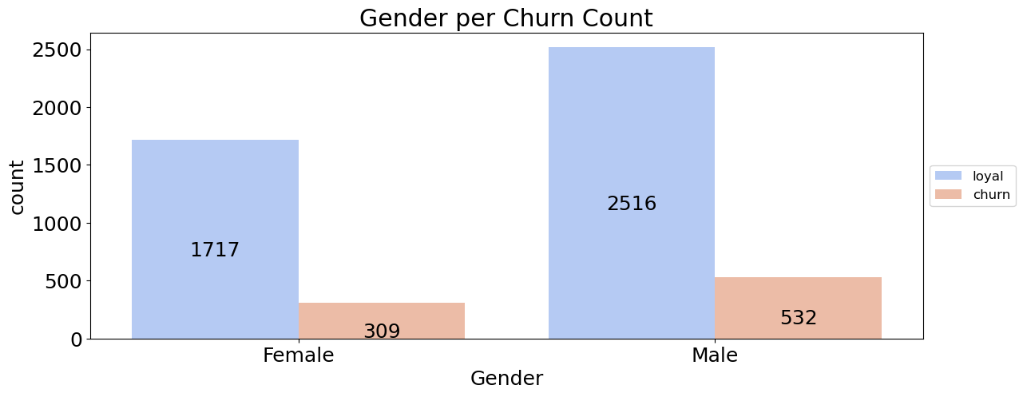
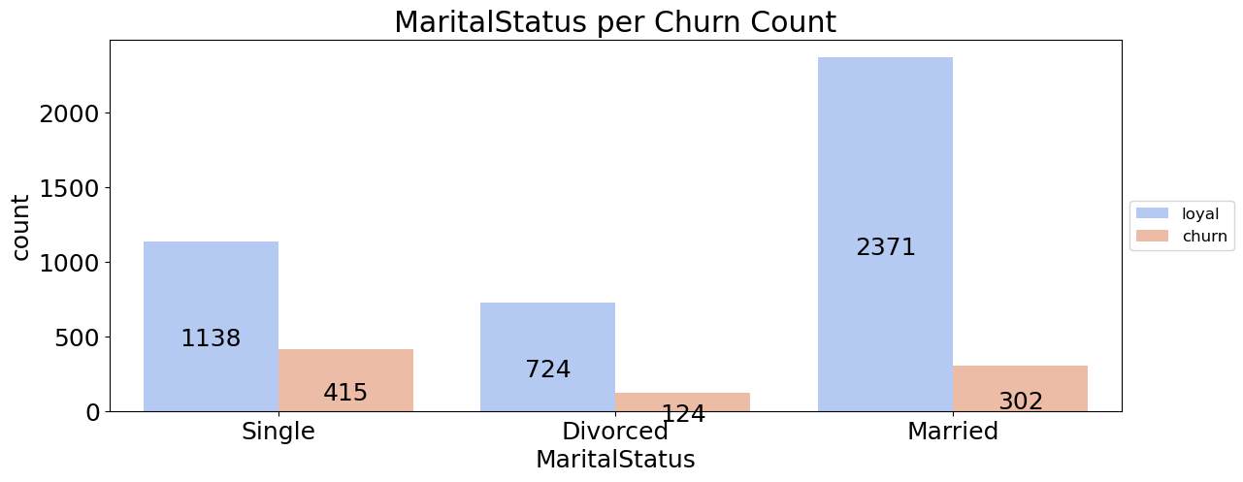
Key Findings: Chi-Square
 | Factor | Significant Diff | Interpretation | Remark
1 | Gender |  | Significant association of churn and variable exist | Female customers tend to be more loyal and less likely to churn compared to male customers.
2 | Marital Status |  |  | Single customers are more likely to churn compared to married or divorced customers.

Slide 16
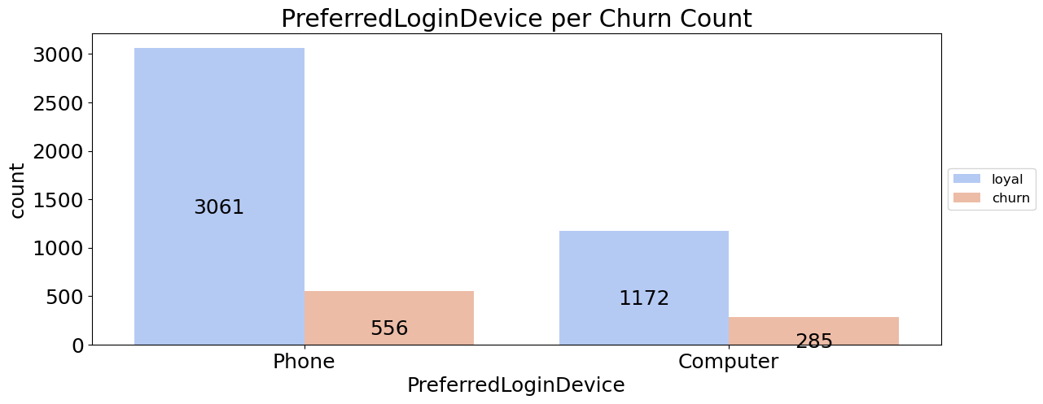
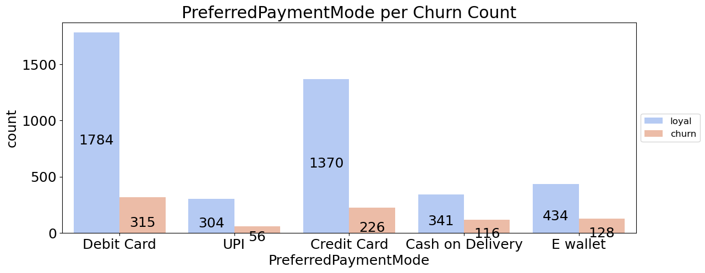
Key Findings: Chi-Square
 | Factor | Significant Diff | Interpretation | Remark
3 | Login Device |  | Significant association of churn and variable exist | Customers who use mobile devices to login are more likely to churn compared to those who use computers.
4 | Payment Mode |  |  | Some payment methods may be associated with frequent failures or extra charges, leading to higher churn rates.

Slide 17
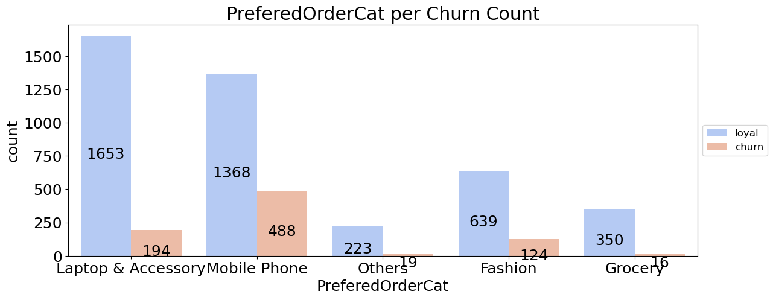
Key Findings: Chi-Square
 | Factor | Significant Diff | Interpretation | Remark
5 | Order Category |  | Significant association of churn and variable exist | Customers may be dissatisfied with the service provided for specific categories of orders, leading to higher churn rates.

Slide 18
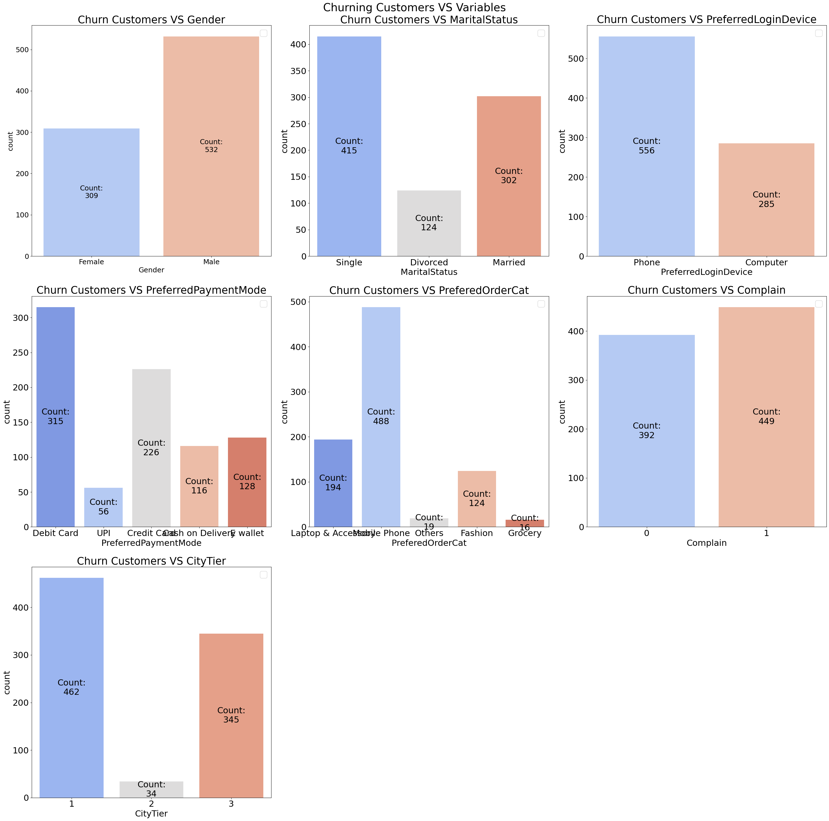
Churn Customers Analysis
Process | Interpretation
Descriptive analysis of churn customers only | Pattern of churn customers

Slide 19
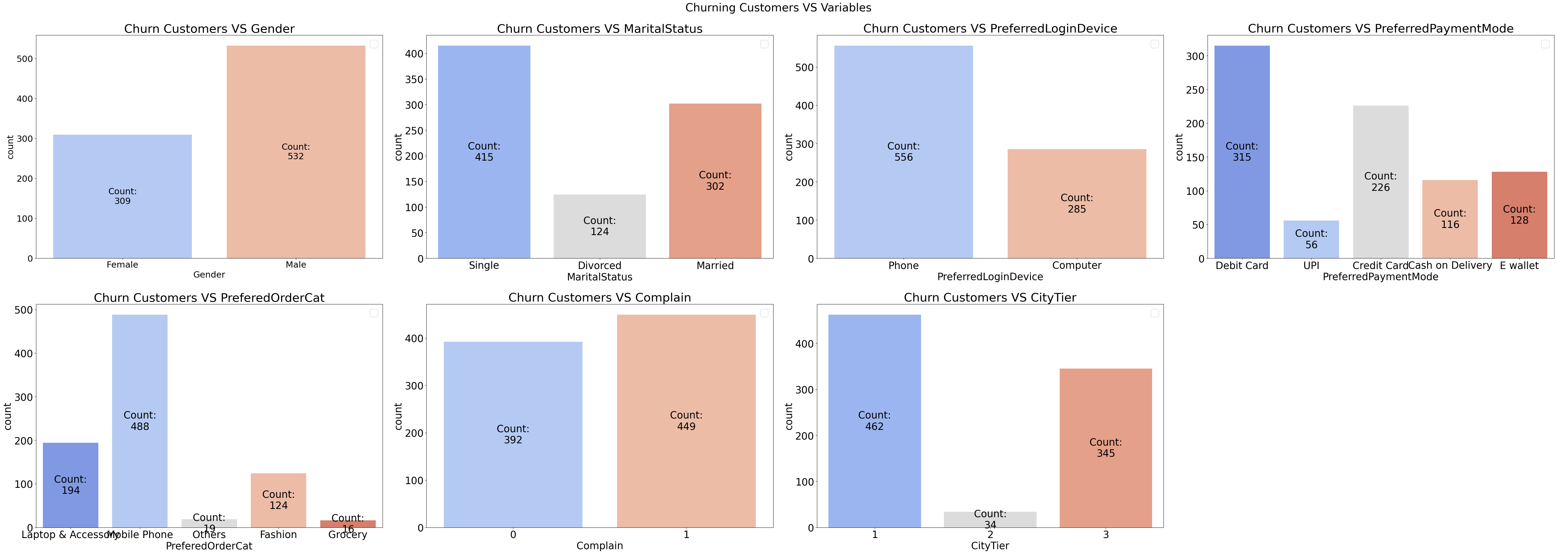
Highlights:
- 65% churn customers use Debit and Credit Card
- Only 4% churn customers from City Tier 2
- 81% churn customers bought technology device (mobile phone + Laptop)
- High percentage of phone user

Slide 20
Review & Highlights
Churn and loyal customers has similar number of coupons, hour on app, order count and order amount increase from last year. May mean pricing and sales part are good
Customers who use certain device may encounter technical issues which could affect likelihood of churning
81% churning customers bought tech device (laptop or phone)
Anomaly in higher satisfaction for churn group
High number of payment mode failures
Gap between customer expectation and current service & product
Our company is preferred by a specific demographic of customers, including a particular gender and marital status.

Slide 21
Recommendation
 | Problem | Recommendation | Output
1 | Technical issue in devices | Clear UI/UX | Seamless buying process end-to-end
2 | Gap between customer expectation and existing service & product | Analyze complaints | Accurate improvement
3 | High number of churn customers bought tech products | Filter seller | Higher quality products
4 | Certain gender and marital status tend to churn | Personalized ads | Favored by all gender and marital status
5 | Payment method difficulty | Simplify process | Easy transaction

Slide 22
Impact Effort Matrix
 | Recommendation
1 | Clear UI/UX
2 | Analyze complaints
3 | Filter seller
4 | Personalized ads
5 | Simplify payment process
Impact
2
5
3
4
1
Effort

Slide 23
03
Machine Learning
You can describe the topic of the section here

Slide 24
Process
Preprocess
Modelling
Hyperparameter Tuning
Drop duplicates
Drop outliers
Impute missing value
Scaling
Encoding
Cross validation base model of:
Logistic regression
K-NN
Decision tree
RF
AdaBoost
Gradient boosting
XgBoost
Tune top 2 models
Notes:
State stakeholder, data tahun berapa, role kita apa

Slide 25
Preprocessing
1
2
3
Drop duplicates
Drop outliers
Impute missing value
Drop 556 duplicates
Drop outliers in tenure, number of address and warehouse to home
Fill in missing value with median on 7 feature
4
5
Scaling
Encoding
Scale numerical features
One-hot encode categorical variables

Slide 26
Modelling
 | Algorithm | Average | Standard Dev.
1 | K-NN | 88% | 2.3%
2 | XGboost | 85% | 1.8%
3 | Gradient Boosting | 83% | 2.9%
4 | AdaBoost | 83% | 4.1%
5 | Random Forest | 80% | 2.5%
6 | Logistic Regression | 80% | 3.8%
7 | Decision Tree | 77% | 5.7%

Slide 27
Hyperparameter Tuning
 | Before | 1st Tuning | 2nd Tuning
K-NN | 91% | 96% | 98%
XGboost | 93% | 95% | -
K-NN has the best score.

Slide 28
How KNN Works
Method
Strength
Weakness
Use nearest data point to make prediction
Picks majority of class among its neighbours
Easy to implement and understand
Non-parametric algorithm, which requires no assumption
Works well for linear and non-linear data
Slow for large dataset
Choice of number of neighbor is very crucial
Sensitive to choice of distance metrics

Slide 29
Best Parameter
Parameter | Value
Model | K-NN
Recall Score | 0.988
Scaler | MinMaxScaler()
Poly Degree | 3
Sampling | SMOTE
Model weights | Distance
Model p | 2
Model N-neighbours | 13
Model leaf size | 10
Model algorithm | Kd tree

Slide 30
Confusion Matrix
 | Not Churn Predict (0) | Churn Predict (1)
Not Churn Actual (0) | 680 | 167
Churn Actual (1) | 6 | 162

Slide 31
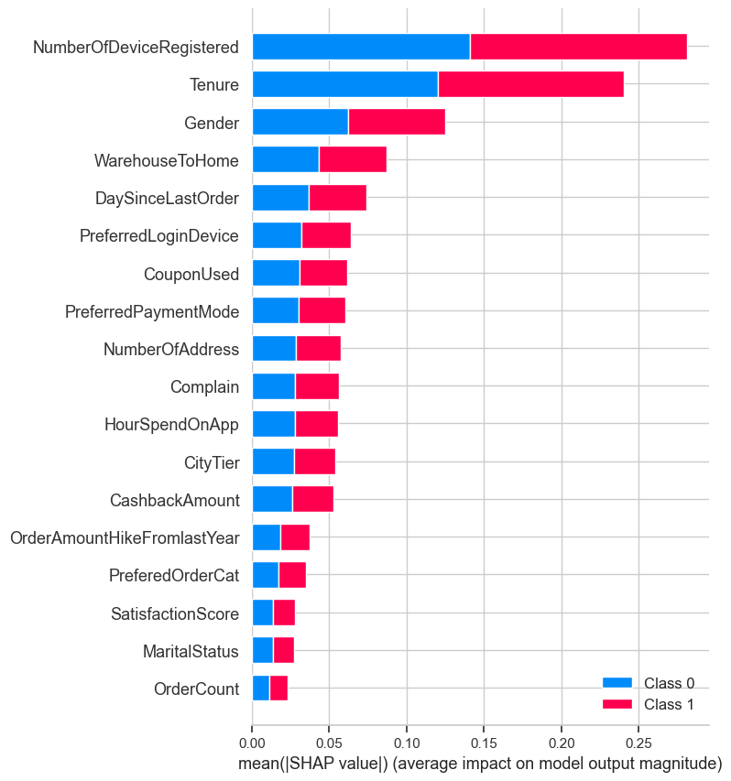
Feature Importance
Higher shap value means greater impact on determining outcome
Number of device registered, tenure, gender, are top 3 variables that has the highest impact on the model

Slide 32
Model Limitation
Feature | Range
Churn | 0 & 1
Tenure | 0-60
Preferred login device | Computer, Mobile Phone, Phone
City tier | 1,2,3
warehouse to home | 5-127
Preferred payment method | Credit Card, Debit Card, Cash on Delivery, CC, UPI, COD, E Wallet
Gender | Male, Female
Number of hours spend | 0-5
Total number of deceives registered | 1-6
Feature | Range
Preferred order category | Fashion, Grocery, Laptop & Accessory, Mobile, Mobile Phone, Others
Satisfactory score | 1-5
Marital status | Divorced, Married, Single
Total number of added added on particular customer | 1-22
Complaint | 1-0
Percentage increases in order from last year | 11-26
Total number of coupon has been used | 0-16
Total number of orders has been placed | 1-16
Day Since last order | 0-46
Average cashback | 0-324
Limited to only 18 features
Not including outliars

Slide 33
How Machine Learning Helps Our Business
Before ML
After ML
Parameter | Value
# Lost customer | 167
% Customer Lost | 16.5%
$ | $6,680
Parameter | Value
# Lost customer | 6
% Customer Lost | 0.5%
$ | $240
Notes:
Perhitungannya diperjelas

Slide 34
Recommendation Machine Learning
Model
Business
Monitor performance regularly
Consider adding more data
Regular testing and validation
Works with experts or crossfunction
Implement model to identify churning customers to send personalized message
Notes:
Dikaitkan dengan eda

Slide 35
04
Conclusion & Recommendation

Slide 36
Conclusion
Promos and Pricing are Fine
Payment & Product Issue
98% Recall score
No significant difference were found for coupon used, order hike, and order count.
High number of churn customers with payment issue and product quality
Model can predict churn customers to prevent them from stopping

Slide 37
Recommendation
Mercury
Venus
ML can target high-risk customers for customized marketing campaign
Analyze complaints and satisfaction further

Slide 38
In God we trust, all others bring data

